Slide 1
Modelling vortex avalanches
Owen Rowell – Year 4 Project

Slide 2
Overview
Theory behind vortices in superconductors
The avalanche system
Simulation results
Criticality and fitting power laws

Slide 3
Type-II superconductors and vortices
Type-II superconductors allow some flux to penetrate as vortices
Larger fields create more vortices
Vortices induce currents creating a repulsive force
Leads to the formation of vortex lattices
Notes:
Superconductors are known primarily for their zero resistance but also their ability to expel magnetic flux from their bulk through the Meissner effect.
However in type-II superconductors, flux can penetrate the medium through vortices. These are tubes through the material in which the metal is in a normal rather than superconducting state. It is through these that magnetic flux passes through the bulk
Each one of these carries a single quantum of flux meaning that the number of vortices is proportional to the applied magnetic field
As with any spatially varying magnetic field, the field through each vortex induces a current in the surrounding superconductor due to Ampere’s law. The interaction of this current with other vortices via the Lorentz force leads to a repulsive interaction between vortices creating vortex lattices which are typically triangular in nature

Slide 4
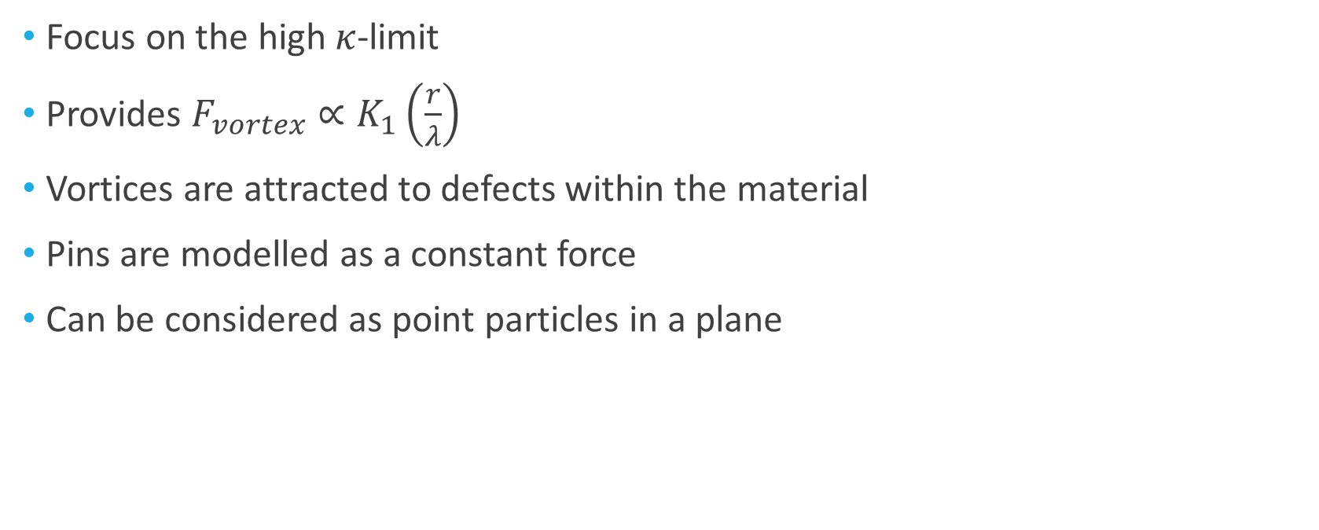
Vortex motion
Focus on the high $κ$-limit
Provides $F_{vortex}∝K_{1}\left(\frac{r}{λ}\right)$
Vortices are attracted to defects within the material
Pins are modelled as a constant force
Can be considered as point particles in a plane
Notes:
In order to model systems of vortices we must consider the two forces that act on them
My work focused on the high kappa limit as here the radius of vortices is much smaller than the length scale in which the magnetic field around them decays. This allows the field carried by the vortex to be modelled as a Dirac delta function. This allows equations for the repulsive force between vortices to be solved analytically giving a radial force governed by a Bessel function
Vortices are also attracted to defects within the material that can be either naturally occurring or added in via doping. These pins disrupt the natural vortex lattice and allow for more interesting phenomena to occur.
These pins are modelled simply as constant forces up to a cut off radius
It is also important to note as well that if the superconducting material is sufficiently thin, then vortices can be considered to take a completely straight path through the sample. This means that they only need to be considered in within a single 2d plane of the superconductor

Slide 5
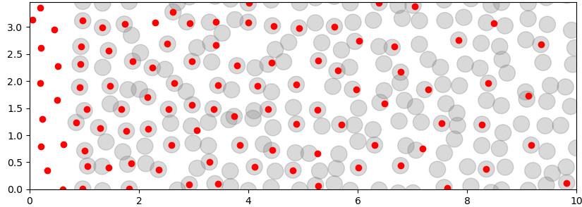
Avalanche system
Randomly arranged pins
Vertically periodic boundaries and mirror images on the left
Vortices added on the left one at a time
Measure the size of ‘events’ upon adding a new vortex
Experimentally done through an increasing magnetic field
Notes:
My project focused on the avalanche system. Here we have a section of superconductor containing randomly arranged pins. Periodic boundary conditions are used in the y direction with the right hand side being the edge of the sample so that any vortices that leave here are removed from the system
The system is driven by individually adding vortices to a random point on the left hand side of the system. Sometimes when a vortex is added, it displaces other vortices from pins which may themselves displace later vortices. The focus of the project was to investigate the conditions needed for such avalanche like events to occur and what determines their size
Experimentally this setup can be achieved through a ramping magnetic field slowly creating vortices on the left side. Event sizes can then be measured through the flux exiting the superconductor on the right, events can sometimes be blurred together if new vortices form before an event has finished. This is avoided by modelling the system computationally as new vortices are only added when an event has ended and the system settled

Slide 6
Initial Results
Pin density of 3.0
Pin density of 5.5
Notes:
These animations are the results of some initial runs with different pin densities. The density here refers to the number of pins per unit area across the system. Grey circles are the pinning sites within which you can see vortices becoming trapped in. The vortices are the coloured circles. The colour refers only to whether the simulation thinks the vortex is currently stationary (red) or not (blue). When all vortices have stopped moving – that is turned red – a new vortex is added on the left hand side
A key feature to notice about these plots is the channel like behaviour that can be seen forming. We do not see what would really be described as avalanches as the vortices are simply flowing between gaps in the pins. This is because the random generation of pins leads to clustering in places leaving these free flowing channels

Slide 7
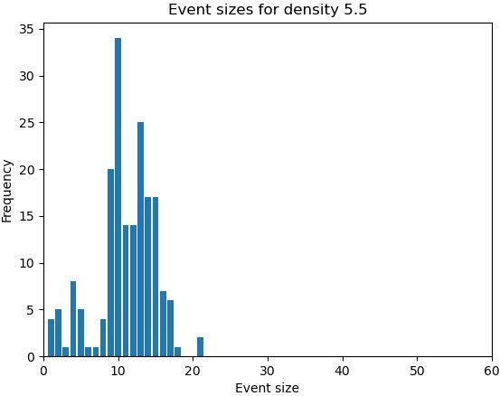
Event sizes
Notes:
The formation of these channels can be most clearly seen in these phase plots. Event sizes are strongly peaked at certain specific values due to a lack of variation in the events that are observed. New vortices are simply causing flow down one or two key channels while most vortices remain completely stationary in their pins

Slide 8
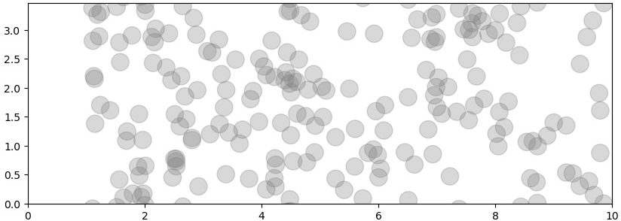
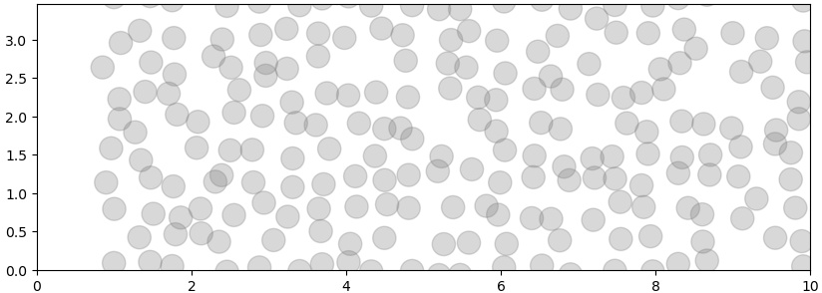
Changing the pin layout
Reduced randomness in pin generation
Placing done by random noise on a grid
Notes:
Before and after of the pinning layout
In order to reduce the chance of these channels forming, the algorithm that randomly generated the pin positions was changed.
The top shows the initial algorithm. Whilst this was fully random, randomness leads to clustering rather than the more homogeneous layout that is desired
Instead, the pins are now generated by placing them in a perfect grid and applying a random offset to each one. Whilst this is now not fully random, it creates more homogenous distributions that will be more susceptible to avalanche behaviour

Slide 9
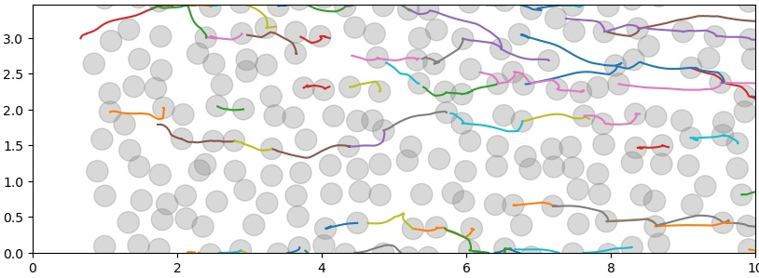
Results with new pins
Notes:
Results following change of pins. Brief discussion of low density but focus on 5.5 density and the avalanche behaviour seen. Could include a path plot for a large event
This animation shows the system using the new pin generation. Here more avalanche like behaviour can be seen with both small and larger events occurring.
As well as showing a larger range of events, the system is now also capable of larger scale events. Previously the largest event seen was just over 20 but the bottom of the slide shows the paths taken of the vortices in a event of size 53

Slide 10
Criticality
Compare to critical regions in thermodynamics
Loss of a length scale leads to power laws
A common comparison to this system is the sand pile
We now look for power laws in the vortex avalanche system
Notes:
Introduce criticality (NB: everyone did phase transitions). Compare this system to a sandpile and the criticality seen there
The avalanche behaviour seen in these systems can be compared to that seen near critical points in thermodynamics
A key phenomena seen in critical regions near phase transitions is the loss of a characteristic length scale the describes the systems behaviour. This loss of a length scale leads to the emergence of power laws to govern the systems behaviour as these do not require any scale.
A system that is often used for this comparison is the sand pile. Here grains of sand are slowly added on to a sand pile, often simply sitting on the pile but also sometimes causing avalanches down the side of the pile. It turns out that this is an example of critical behaviour, with the size of the events corresponding to a power law.
In the same vain, we now look for similar power laws in the event sizes seen in this system. It is important to note however, that a length scale is still expected as we are considering a finite system size. This will take the form of a cut-off above which the power law will cease to apply

Slide 11
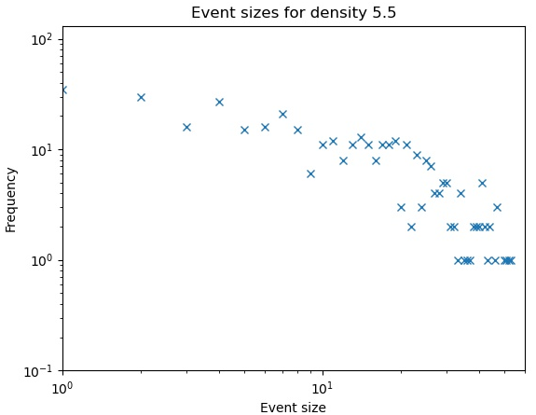
Fitting to power laws
Notes:
The simplest way to look for power laws is to plot the data in a log-log plot as shown here. If the data fits a power law then we expect to see a straight line. This data clearly demonstrates why a cut-off is needed. The data seems to be fairly straight initially but tapers off at the end as the largest events become suppressed by the finite size of the system

Slide 12
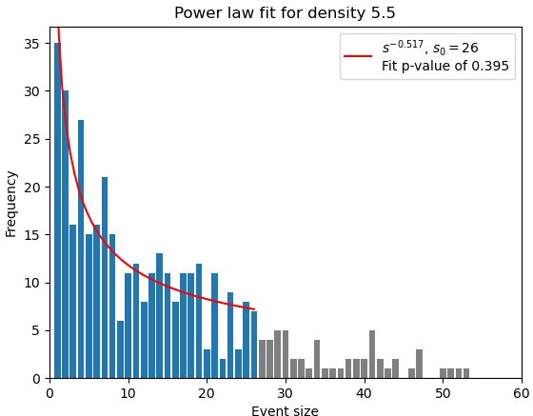
Fitting to power laws
Notes:
This is the plot now with a fitted power law. This was done using most likelihood estimation to calculate the value best value for the exponent and using a range of values for the cut-off to find the best one.
As you can see the curve fits fairly well with a chi-squared goodness of fit providing a p-value of just under 0.4.
However, this still suggests a high chance that the data is not in fact a power law and this is not evidence for criticality. I intend to test this further by running the simulation with different seeds for the random pin generation and for longer time periods in order to gather more data

Slide 13
Conclusions
Some evidence of criticality in the avalanche system
Requires a sufficiently high pin density
Also needs relative homogeneity in the pin distribution
More data is needed to confirm the existence of power laws
Notes:
So to conclude
We can find evidence of criticality in vortex avalanches due to the existence of power laws
This relies however on the system having a suitably high density of pins in order to prevent channels from forming
Channels also can form if the pin layout is too clustered and leaving free flowing areas
However, more data in the form of longer simulations and varied random seeds is needed to provide more certainty on the existence of power laws

